Slide 1
NO CODE GenAI and Agentic AI

Slide 2

WHO AM I?
LinkedIn: https://www.linkedin.com/in/latha-t-k-b21018128/
Data Science ,AIML
Data Analysis ,SQL, PySpark
Data Visualization ,PowerBI, Tableau
Natural Language Processing (NLP)
Computer Vision
Generative AI, Prompt Engineering
BigData and Data Engineering

Slide 3
AI Vs Generative AI

Slide 4


Slide 5


Slide 6


Slide 7


Slide 8


Slide 9


Slide 10
What is Data?

Slide 11
What is DATA?
Data is a collection of facts, figures, observations, or measurements that can be analyzed to gain insights.
It can be structured (like tables in a database) or unstructured (like text, images, or videos).
Data is crucial for decision-making in businesses, research, and technology.

Slide 12
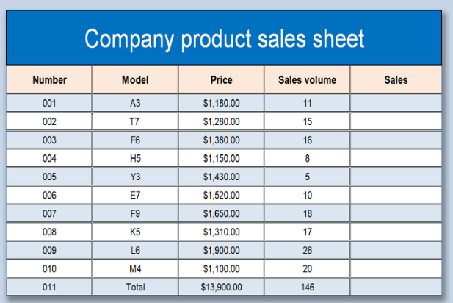
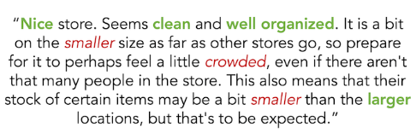

Slide 13
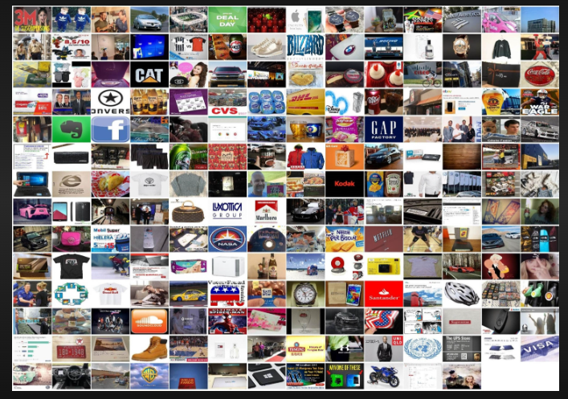
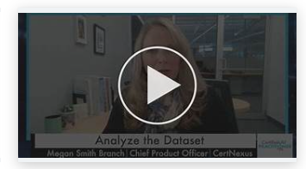
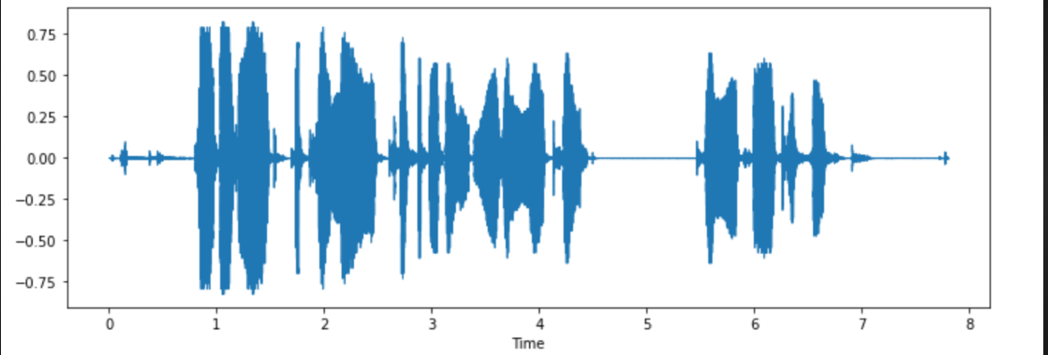

Slide 14
Structured or Unstructured?
Customer purchase history in a database
Video recordings of stock market news
Excel sheet with employee salary data
WhatsApp chat messages
Weather sensor readings

Slide 15
When to Use ML, CV, NLP, and DL?
Each technique—Machine Learning (ML), Computer Vision (CV), Natural Language Processing (NLP), and Deep Learning (DL)—is used based on the type of data and the problem being solved.

Slide 16
Machine Learning (ML)
Use ML when:
You have structured/tabular data (e.g., sales records, customer transactions).
You need to make predictions, classifications, or clustering.
Examples:
Predicting loan approvals (Classification)
Customer churn prediction
Fraud detection in banking
Recommender systems (Netflix, Amazon)

Slide 17
Computer Vision (CV)
Use CV when:
You are working with images or videos.
You need to analyze, classify, or generate images.
Examples:
Face recognition in security systems
Object detection in self-driving cars
Medical image analysis (e.g., detecting tumors in MRI scans)
Defect detection in manufacturing

Slide 18
Natural Language Processing (NLP)
Use NLP when:
You are working with text or speech data.
You need to understand, generate, or translate language.
Examples:
Chatbots and virtual assistants (Siri, Alexa)
Sentiment analysis of customer reviews
Machine translation (e.g., Google Translate)
Email spam detection

Slide 19
Deep Learning (DL)
Use DL when:
Your dataset is large and complex (images, speech, unstructured text).
Traditional ML models do not perform well.
You need high accuracy and have computational power (GPUs/TPUs).
Examples:
Autonomous driving (Self-driving cars)
Image generation (Deepfake technology)
Speech recognition (Google Assistant, Alexa)
Large Language Models (ChatGPT, Gemini,COPILOT)

Slide 20
Problem Statements
A bank wants to predict whether a customer will default on a loan based on transaction history and demographics.
A company wants to classify customer support emails as complaints, inquiries, or feedback.
A factory needs an AI system to detect defects in manufactured products by analyzing images.

Slide 21
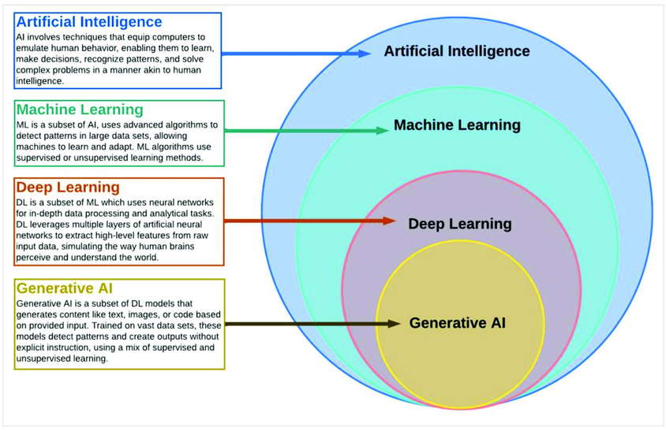

Slide 22
Types of Analytics
In today's data-driven world, information is king. But raw data itself isn't enough.
We need to analyze it to extract insights and make informed decisions

Slide 23






Slide 24
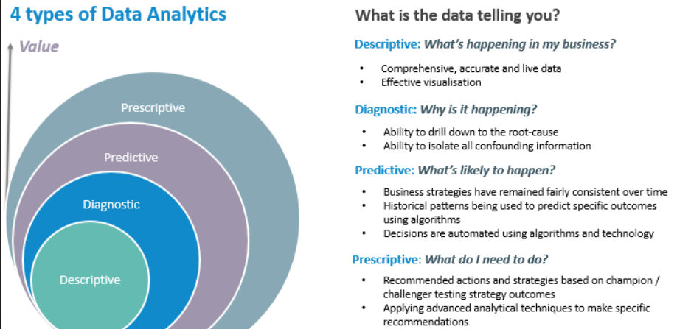

Slide 25
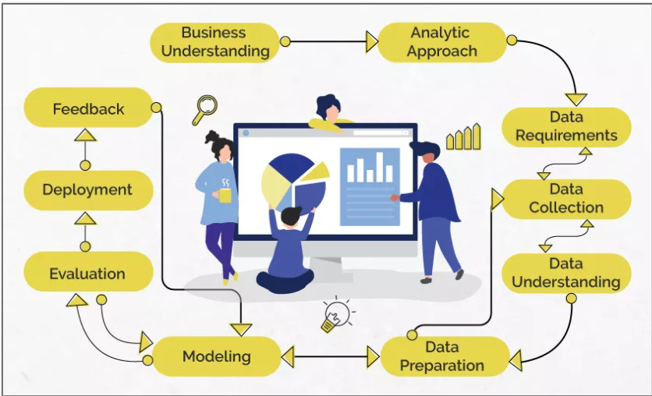
Data Science/Machine Learning

Slide 26
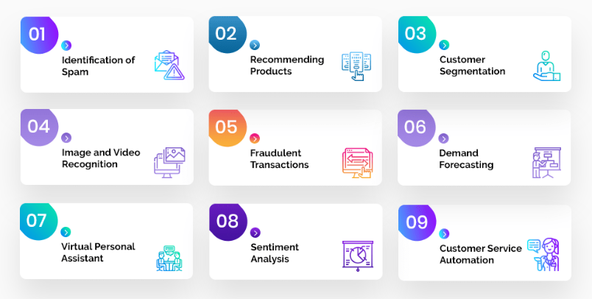
Problem Statement

Slide 27
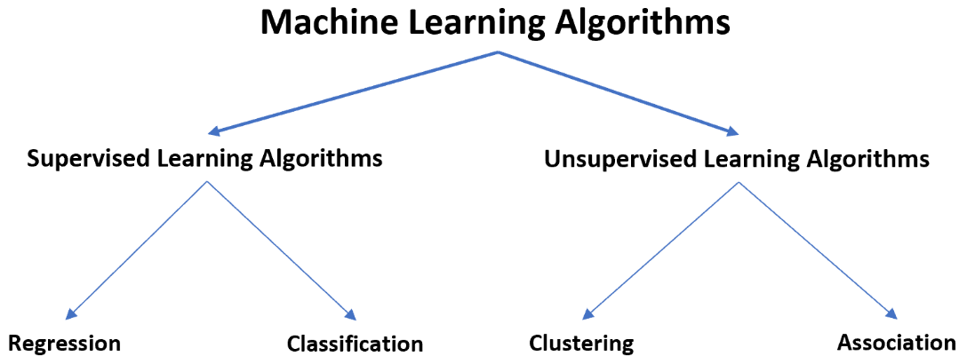

Slide 28
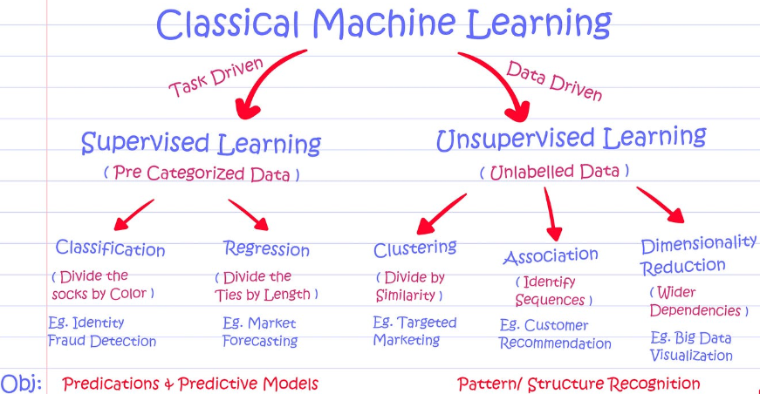

Slide 29
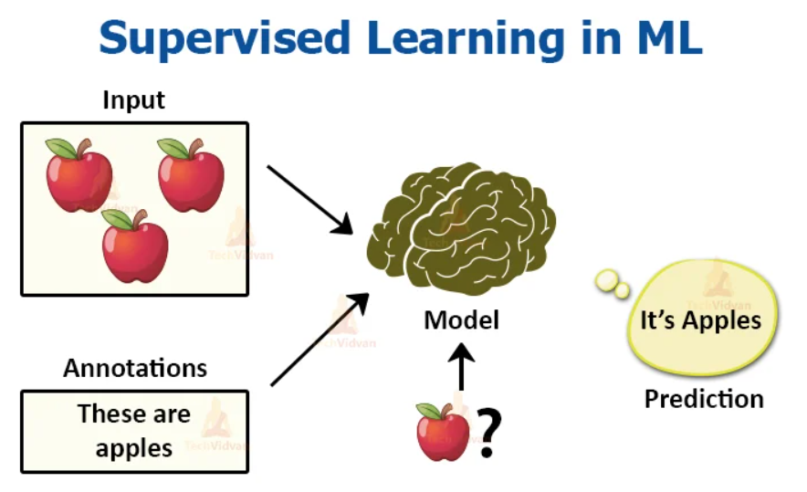

Slide 30
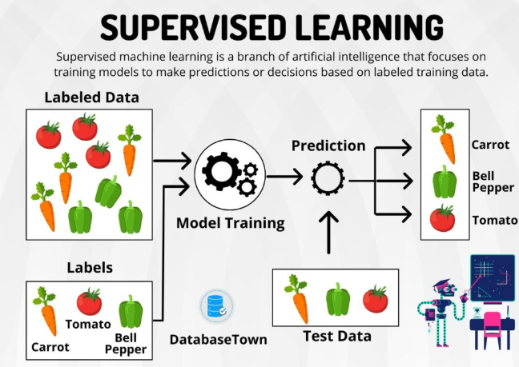

Slide 31
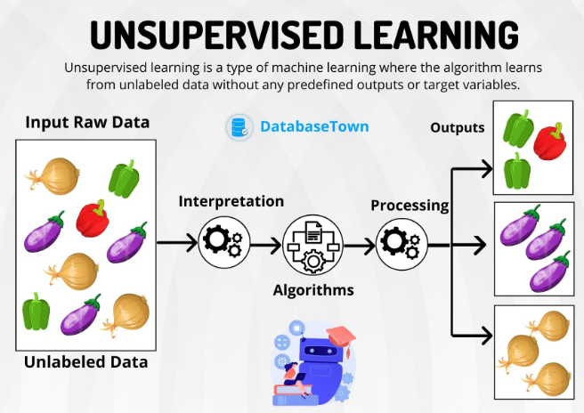

Slide 32
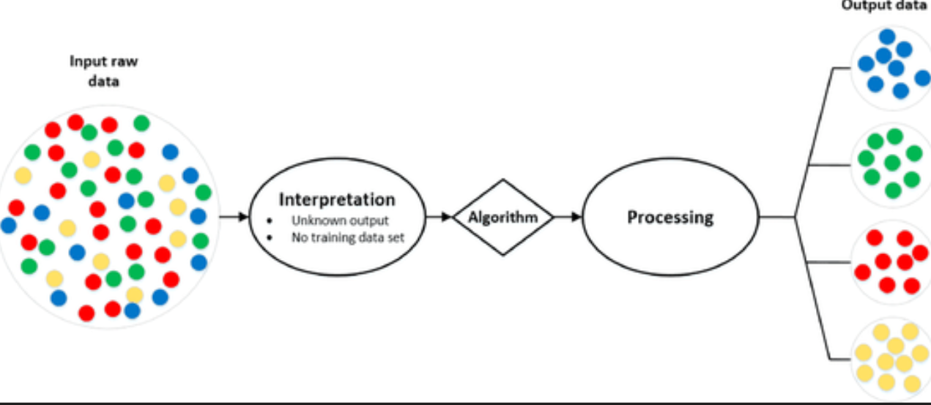
Analytic Approach

Slide 33
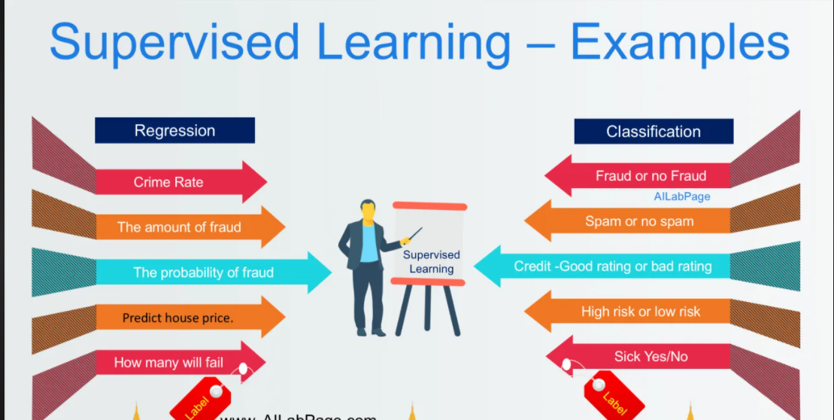
Supervised Learning

Slide 34
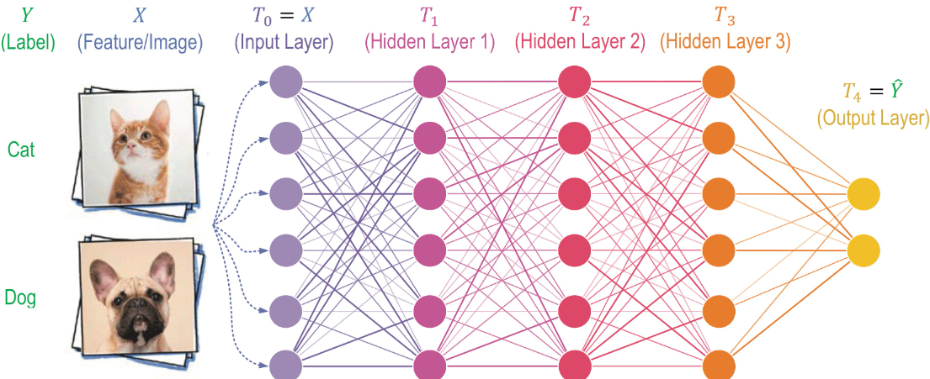

Slide 35
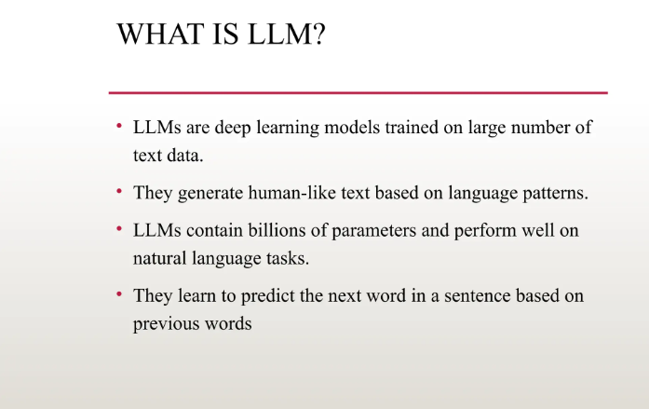

Slide 36
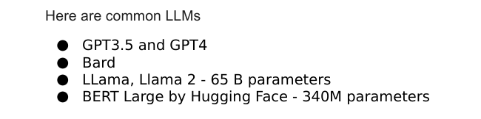

Slide 37
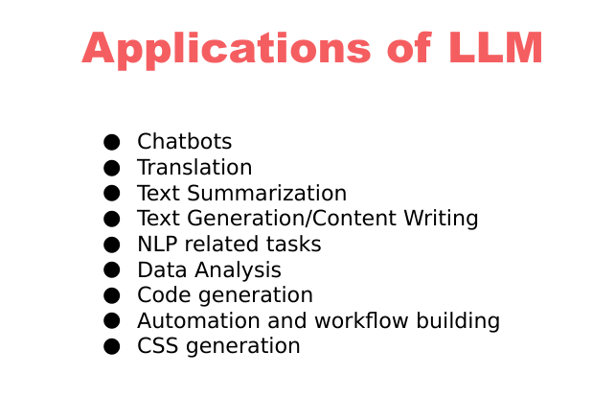

Slide 38
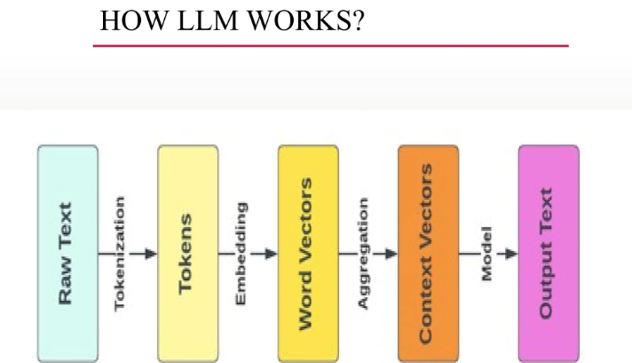

Slide 39
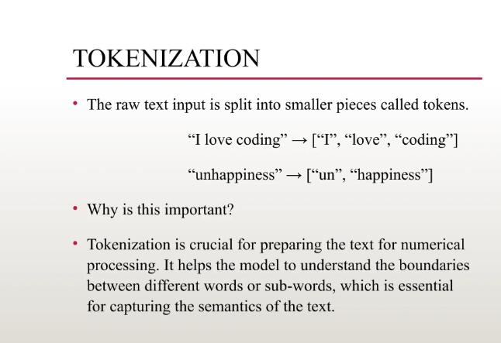

Slide 40
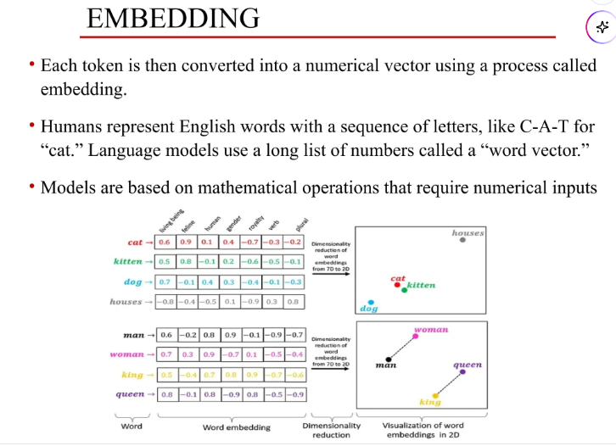

Slide 41
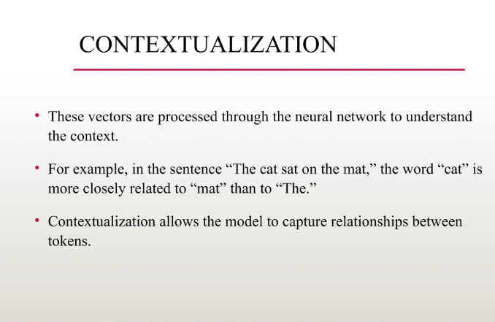

Slide 42
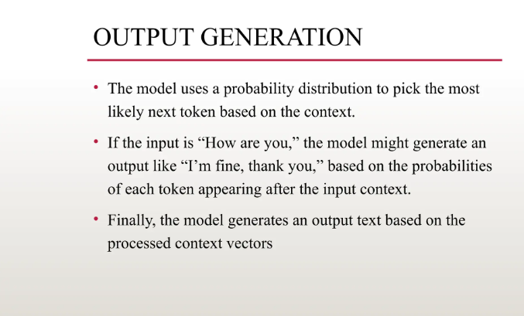

Slide 43
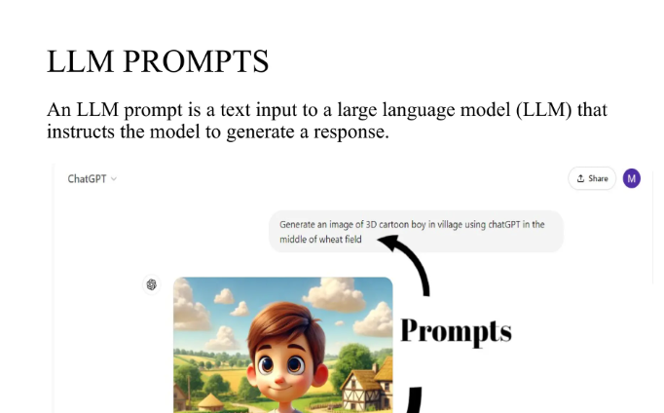

Slide 44
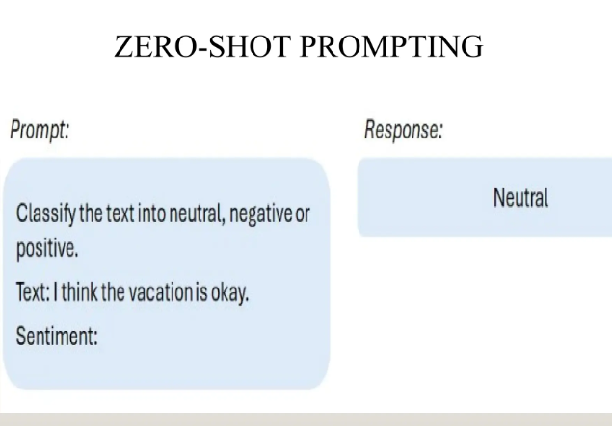

Slide 45
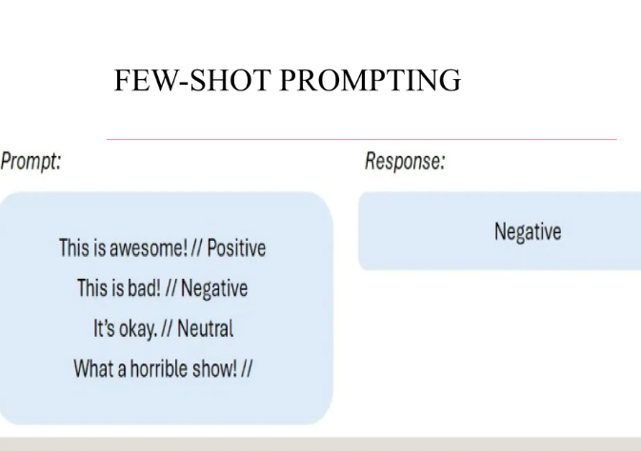

Slide 46
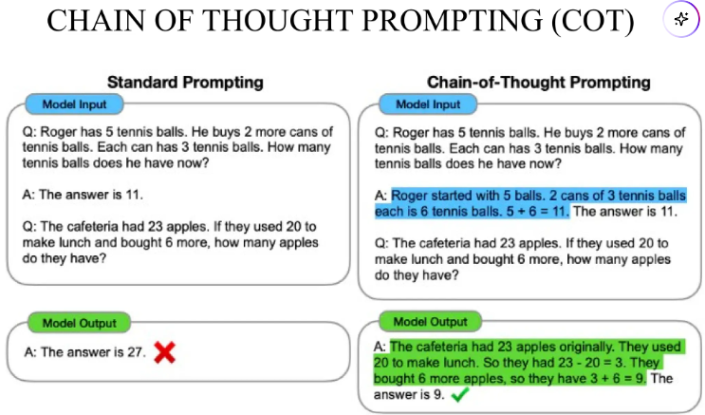

Slide 54
What is Prompt Engineering?
The practice of designing and refining prompts to optimize AI-generated responses.
Helps in guiding AI models like GPT-4 to produce relevant, accurate, and high-quality outputs.
Involves techniques like using clear instructions, providing context, and specifying output formats.
Used in applications such as chatbots, content generation, and decision-making systems.

Slide 55
Methods of Prompt Engineering
Zero-shot Prompting
Directly asking the model a question without examples.
Explain machine learning in simple terms.
What are the key factors affecting stock market prices?

Slide 56
Methods of Prompt Engineering
One-shot Prompting
Providing a single example to guide the AI’s response.
Example: “Translate ‘Hello’ to French: Bonjour. Now translate ‘Goodbye’.”

Slide 57
Methods of Prompt Engineering
One-shot Prompting:
If a person with a credit score of 750 and an income of $80,000 is approved for a loan, what about a person with a credit score of 680 and an income of $50,000?
Few-shot Prompting
A person with a credit score of 750 and income of $80,000 was approved.
A person with a credit score of 600 and income of $40,000 was denied.
A person with a credit score of 720 and income of $70,000 was approved.
Now, predict the loan decision for a person with a credit score of 680 and an income of $50,000."*

Slide 58
Methods of Prompt Engineering
Chain-of-Thought (CoT) Prompting
Encouraging step-by-step reasoning for complex problems.
Example: “Solve 24 × 3 + 12. First, multiply 24 by 3, then add 12.”
An investor is considering buying stocks in Company A. The company's revenue is growing at 10% per year, and it has a P/E ratio of 25. Interest rates are expected to rise next year. Should the investor buy the stock? Explain step by step.

Slide 59
Methods of Prompt Engineering
Role-based Prompting
Assigning a specific role to the AI for better responses.
Example: “You are a customer support agent. Answer the query professionally.”
You are a seasoned financial advisor. A client wants to invest ₹10 lakhs and is looking for low-risk options. Provide a step-by-step investment strategy.

Slide 60
Methods of Prompt Engineering
Persona-based Prompting
Making the AI respond in a particular style or tone.
Example: “Explain quantum physics as if you were a 5-year-old.”
You are the CFO of a multinational company. Your board is considering expanding into India. Analyze the financial risks and opportunities.

Slide 61
Methods of Prompt Engineering
Refinement and Iterative Prompting
Adjusting prompts based on initial responses for better results.
Example: If the response is too vague, rephrase with more details.

